Slide 1
Муниципальное автономное общеобразовательное учреждение Домодедовская гимназия №5
Научно-исследовательская работа по теме:
«Английские надписи на одежде как экстралингвистический фактор, влияющий на культуру подростков»
Выполнила: Макаренко Наталья,
ученица 10 «А» класса
Руководитель: Барменкова Ольга Ивановна,
учитель английского языка
Домодедово, 2020

Slide 2

Definition of Fashion
Fashion - a popular aesthetic expression in a certain time and context, especially in clothing, footwear, lifestyle, accessories, and makeup, hairstyle and body proportions. Whereas, a trend often connotes a very specific aesthetic expression, and often lasting shorter than a season

Slide 3

Aims
to establish what semantic loading the inscriptions on clothes bear
to find out how the extralinguistic importance of these signs affects on teenage culture
Object
English inscriptions on clothes of teenagers in our school
understanding of English inscriptions on clothes can change and affect on culture of adolescents

Slide 4
Methods of Research
Theoretical:
Practical:
gathering the information
analyzing the information
classification of the collected materials
collecting materials from books, web pages
selecting of specific material
conducting a survey among teenagers

Slide 5

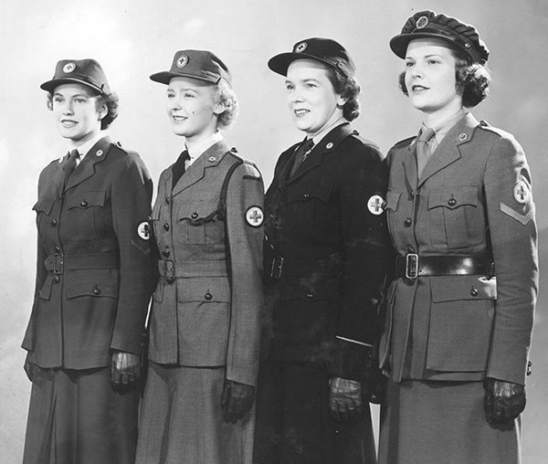
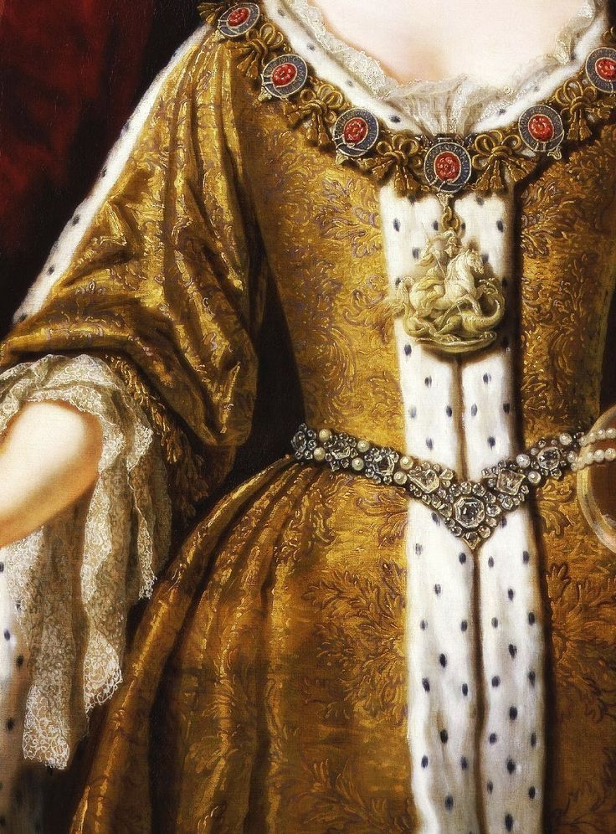
The History of Clothes’ Inscriptions
Greece: embroideries on belts and jewelry
Renaissance: inscriptions woven into the ornaments of shirts and dresses
20th century: the uniform of workers.

Slide 6
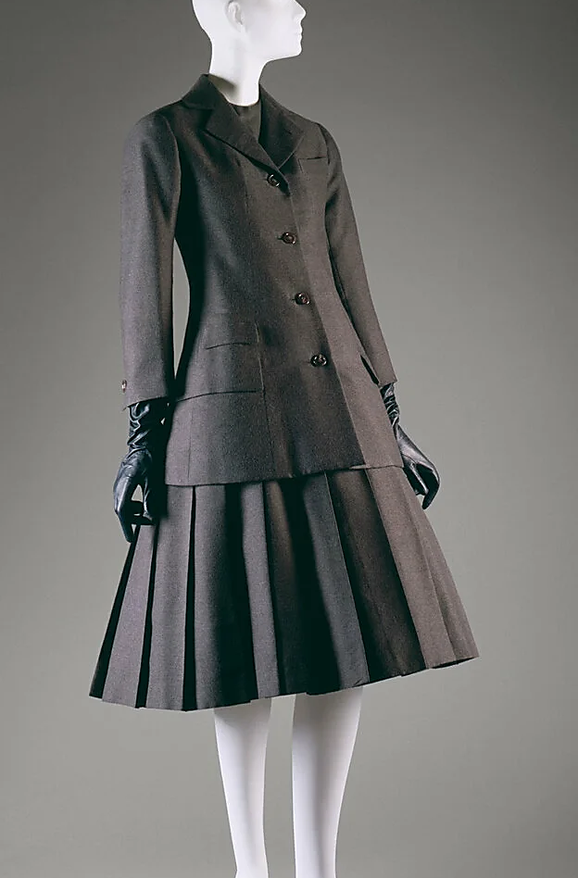


Christian Dior’s Collection
Theme of the three letters: X, A, and Y

Slide 7
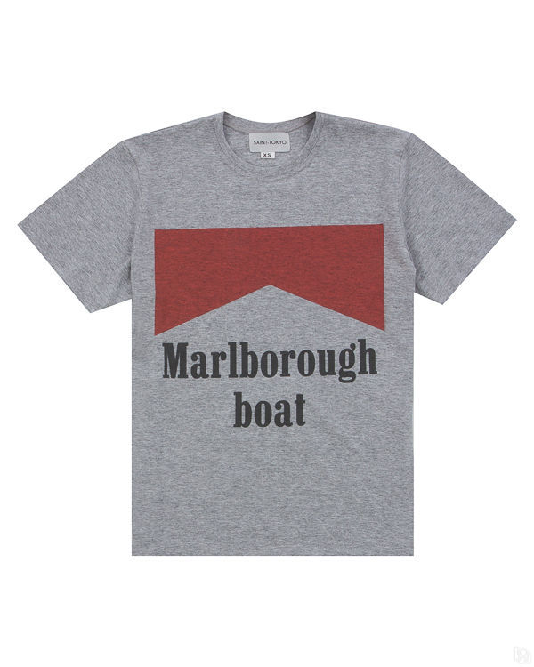
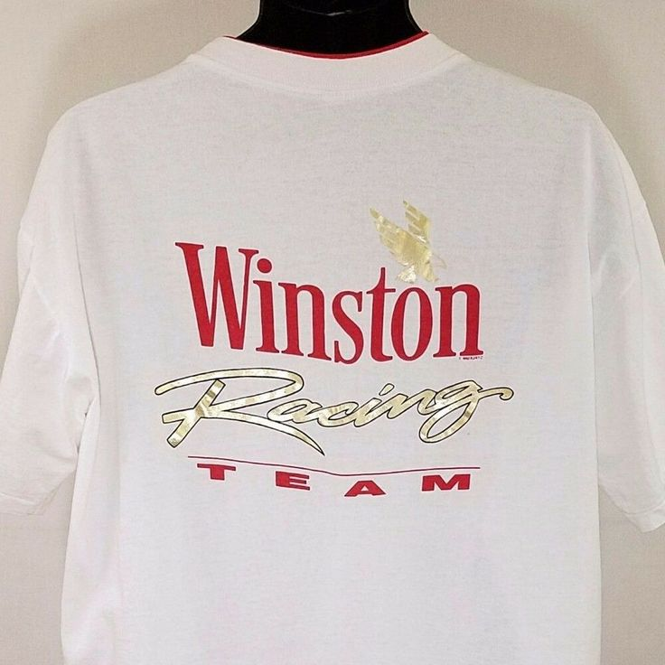
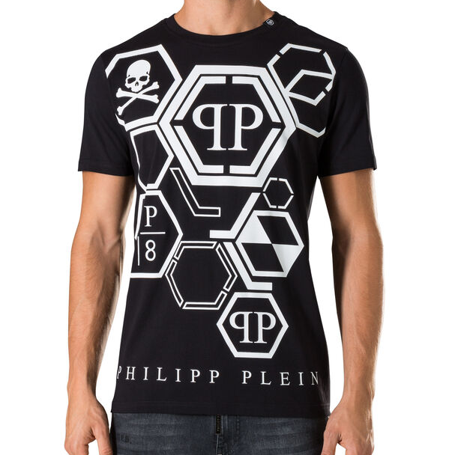
T-shirts with the Brand of Cigarettes

Slide 8
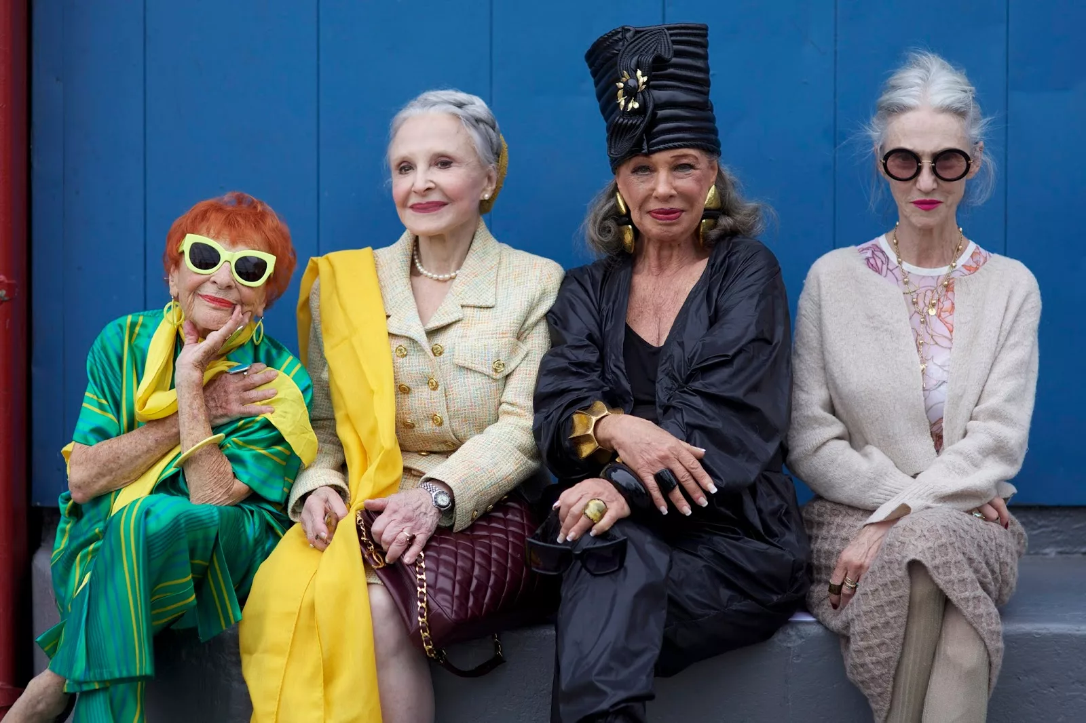
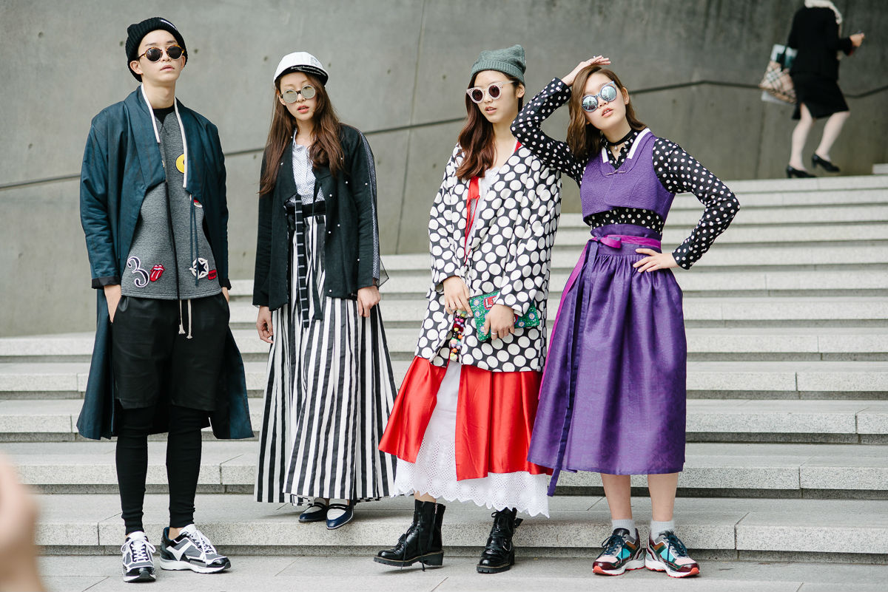
Fashion for Different Generations

Slide 9
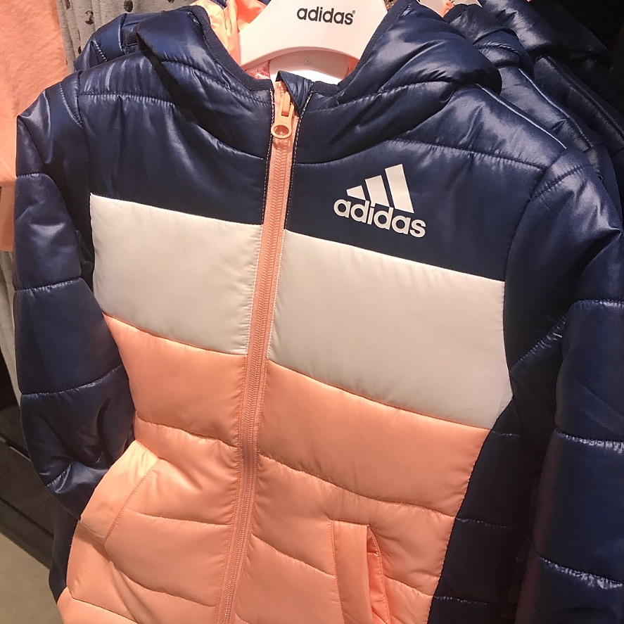
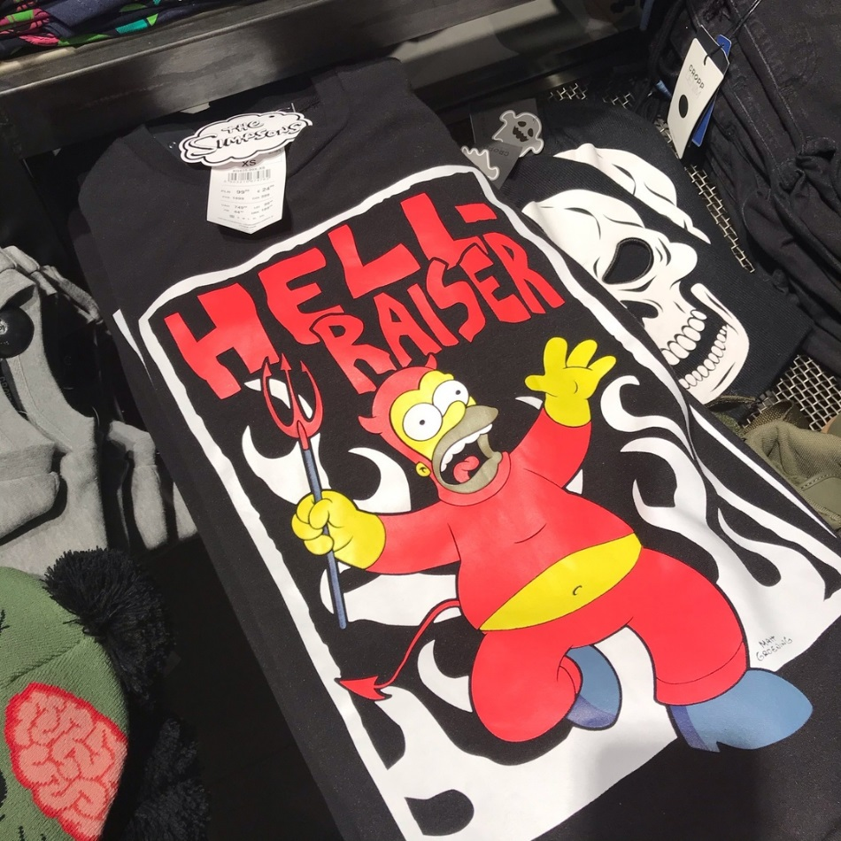
Semantic Classification Labels on Clothes
Funny words/phrases
The name of brand

Slide 10
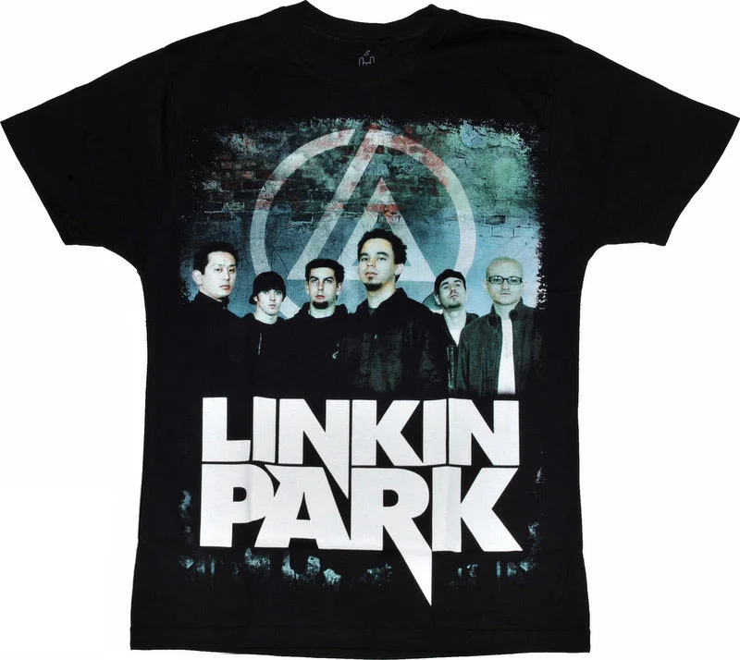

Semantic Classification Labels on Clothes
Bands or directions in music
Negative, abusive, obscene words/ phrases

Slide 11

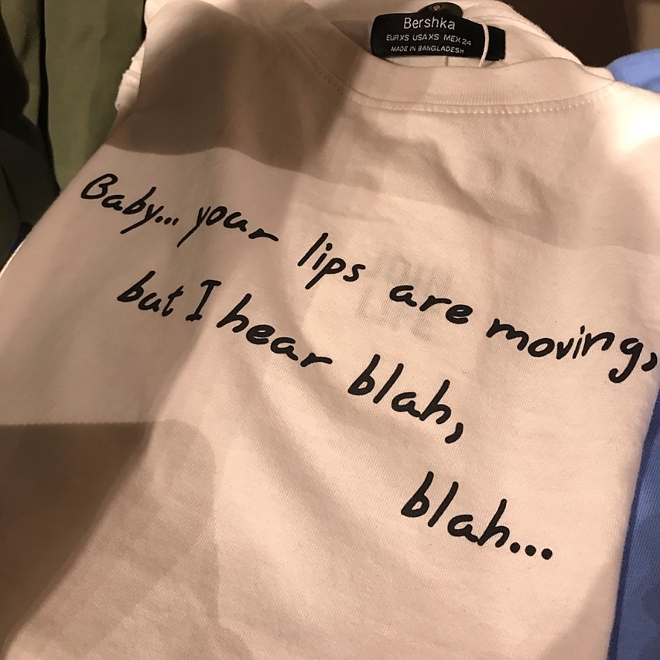


Contact with the opposite sex
Politics or ecology

Slide 12
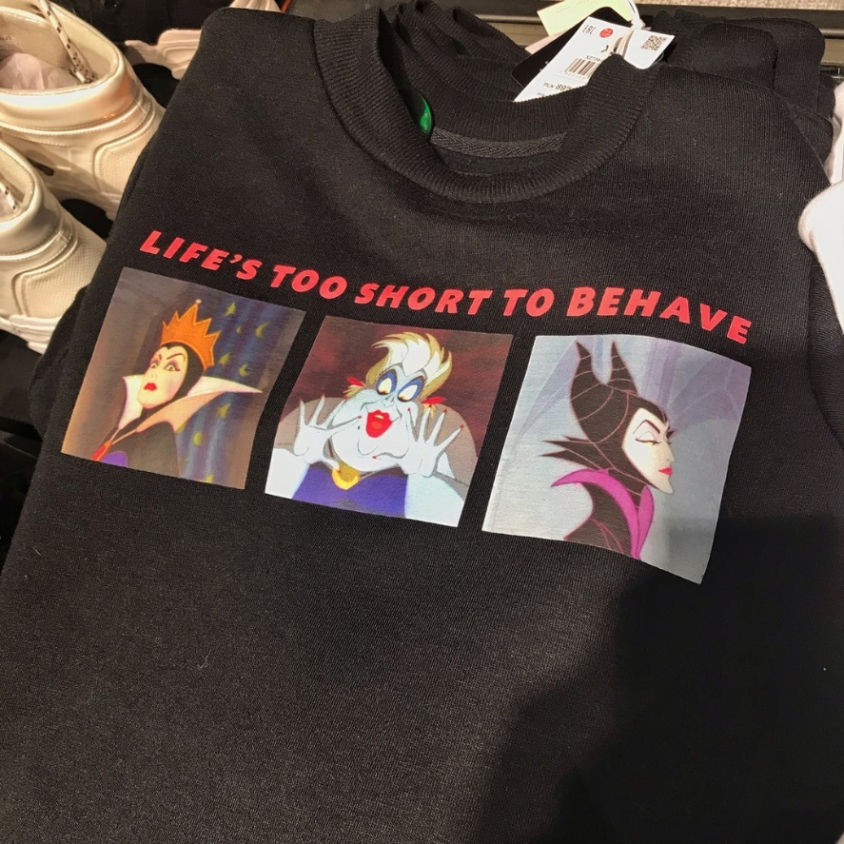
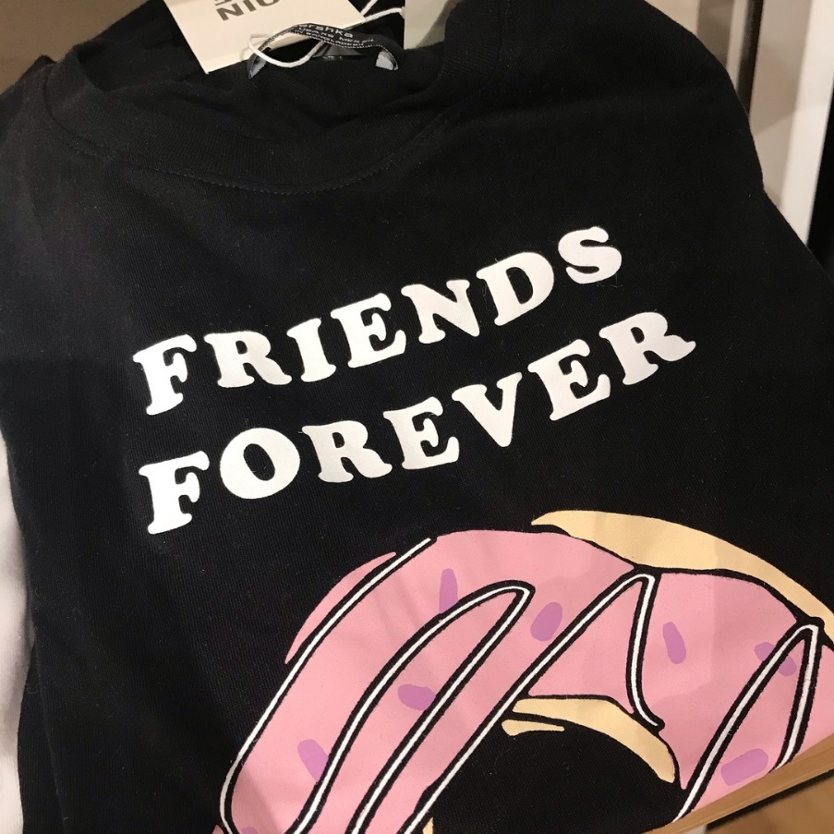

Neutral meaning

Slide 13
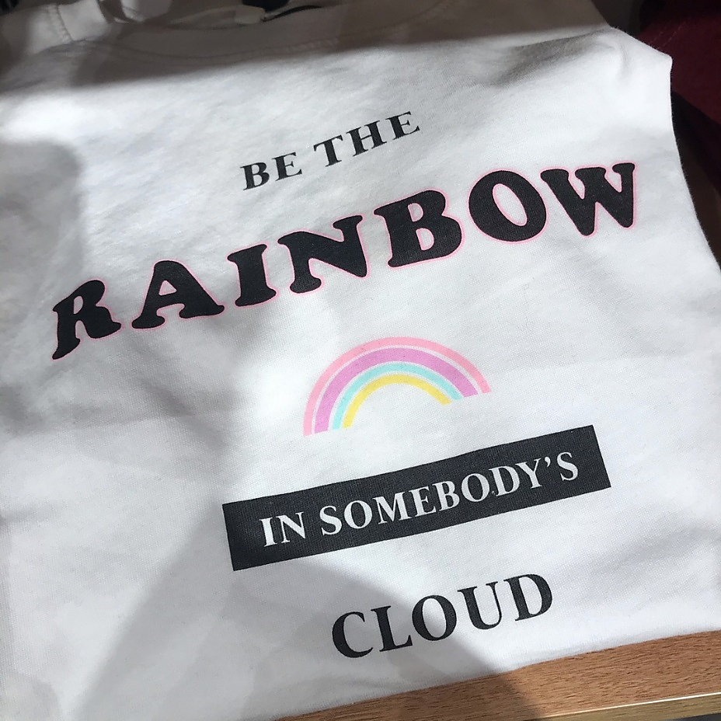
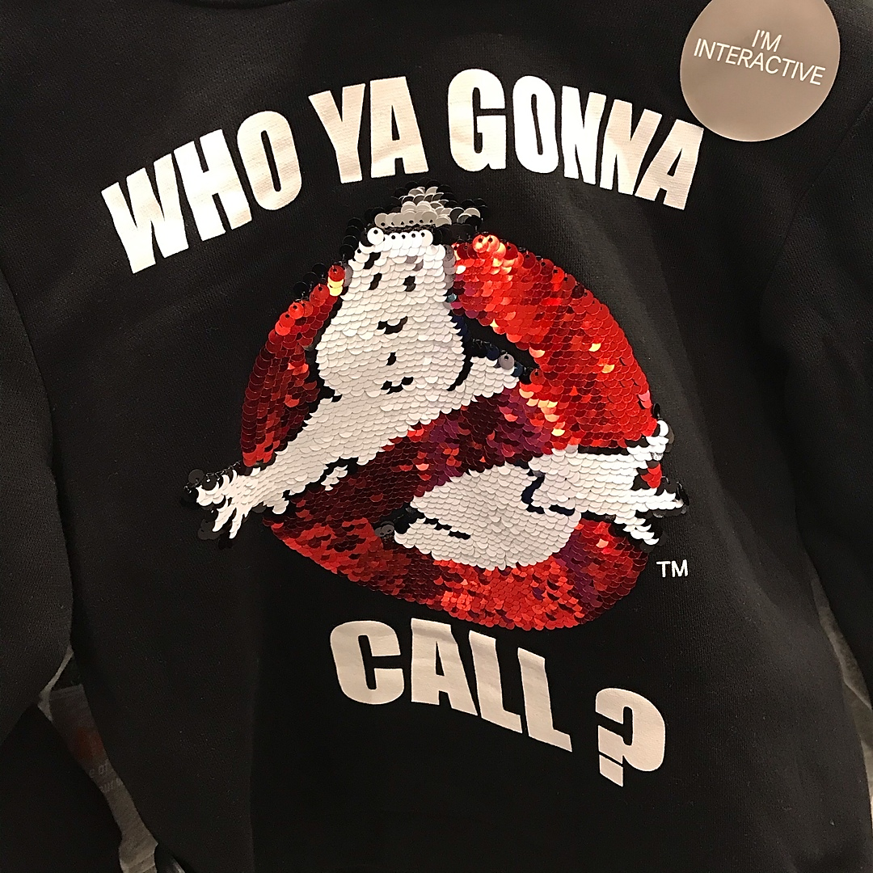
Quotes
Abbreviated forms

Slide 14
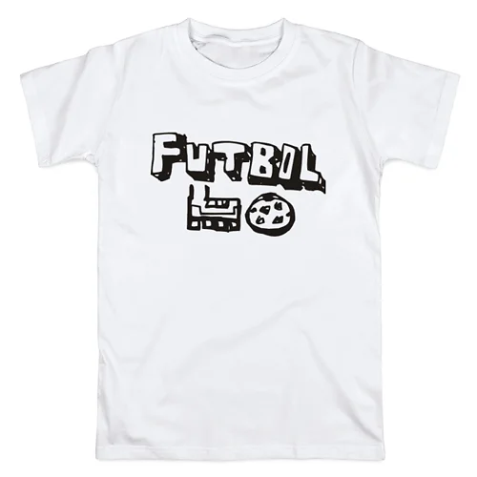
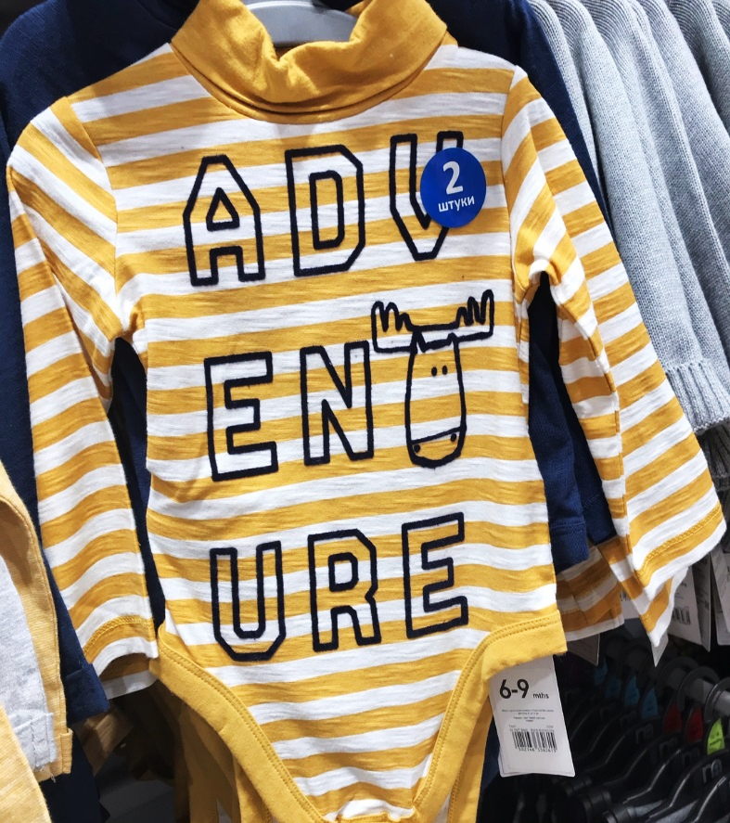
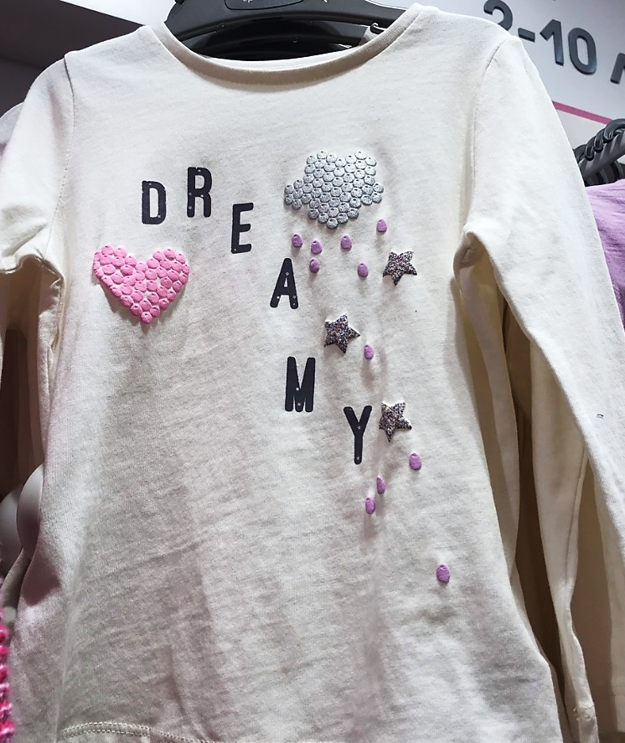
Lexical and grammatical errors
Divided into parts

Slide 15
Sociological Questionnaire

Slide 16


Slide 19
The Results of a Sociological Study
76% of adolescents know the meaning of the labels on their clothes
24% of students do not care about the meaning of these inscriptions
44% of students’ clothes belong to classification of neutral prints

Slide 20
Conclusion
Fashion is always going with the times
Clothes with inscriptions in English become popular not only among children, but among adults too
About 75% of teenagers have clothes with English inscriptions in their wardrobe.
Interviewers from grades 9 and 10 almost always translate labels on clothes before buying them.
Interest in the meaning of inscriptions among 8 classes is not so high.

Slide 21
The hypothesis of our study is confirmed: interest in learning the language and understanding of various inscriptions of a foreign language is growing among the younger generation.
Practical significance: our presentation can be used in extracurricular and elective classes that will be devoted to fashion and adolescent culture
Conclusion

Slide 22
Bibliography
1. Булыко А.Н. Большой словарь иностранных слов.- Мартин, 2007
2. Журнал «MYLLITA». Надписи и тексты на женской одежде.-2018
3. Максимова М.А. Осторожно, говорящая одежда!// Юный ученый. – 2015.
4. Мюллер В.К. Англо-русский словарь. – М. – 1960.
5. BoF Education Fahion Course// Fashion History. -2015
6. Logman Dictionary of Contemporary English.
7. Oxford Student’s Dictionary of Current English. Oxford A.S.Hornby.19
8. Wikipedia. History of fashion design. https://en.wikipedia.org

Slide 23
THANK YOU FOR
YOUR ATTENTION!!!

