Slide 1

Муниципальное Автономное Образовательное Учреждение
Домодедовская Гимназия №5
SMS Language in Modern English
Автор: Киселева Екатерина,
обучающаяся 10 класса
Научный руководитель: Барменкова Ольга Ивановна,
учитель английского языка, доцент
Домодедово, 2020

Slide 2
Object of the research: SMS language
Hypothesis: using SMS language as the way of communication is more economical and convenient than live communication
Main aim: to study and research the features of the SMS language and reveal how SMS language influences on communication

Slide 3
Methods of Research
Theoretical
Practical
Gathering and analyzing the information
Systematization and classification of the collected materials
Collecting materials (books, web pages, dictionaries)
Translation with a dictionary
Conducting a survey

Slide 4

What is SMS?
SMS is abbreviation from “Short Message Service”, a system for sending short written messages from one mobile phone to another

Slide 5
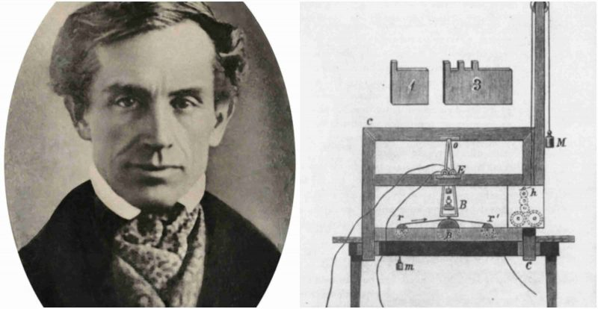
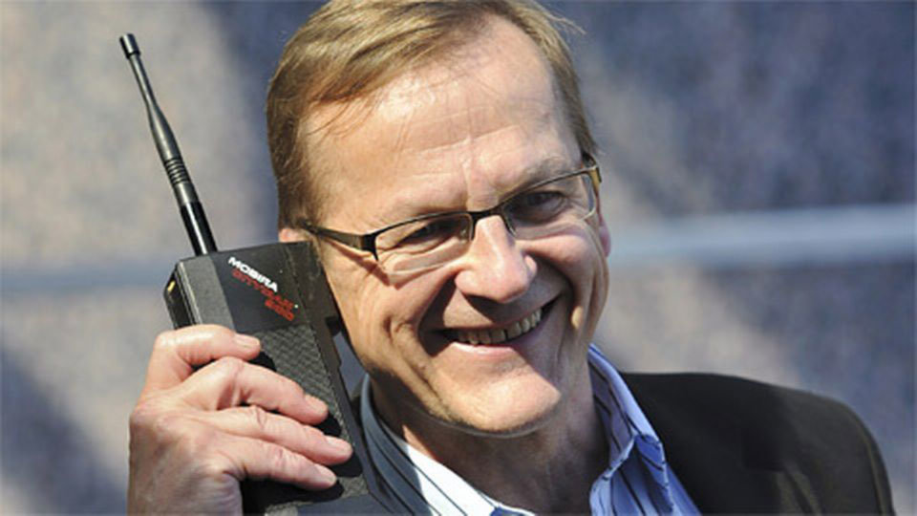
The history of SMS
First telegraph was invented in 1837
The “Father” of SMS was a Finnish civil servant Matti Makkonen
Neil Papworth sent the first message on the 3rd of December 1992

Slide 6

Advantages of Using SMS
This is more discreet than a telephone conversation
SMS is the fastest way of communication
SMS is a convenient way to communicate with deaf and hard of hearing people
SMS lets insecure people forget about shyness
It does not demand the answer right away
SMS allows sending messages to a large number of people at the same time
You can use SMS to get reminders to your phone

Slide 7

Disadvantages of Using SMS
SMS communication reduces the need for deep and sincere conversations
SMS texting downs grammar and spelling
Texting distracts from life
Texting is not always understandable

Slide 8



Classification of SMS Language Elements
Were proposed by Crispin Thurlow, López Rúa and David Crystal

Slide 9
Rules and Recommendations Using and Creating SMS Language Element
Single letters replace words
Single digits replace words
Single letter or digit can replace a syllable or phoneme
Combinations can shorten a single or multiple words

Slide 10

Single Letters Replace Words
Be becomes b
See or sea becomes c
Okay becomes k
You becomes u
Are becomes r
Why becomes y
In becomes n
And becomes n

Slide 11

Single Digits Replace Words
Won or one becomes 1
To or too becomes 2
For becomes 4
Ate or becomes 8

Slide 12

Single Letter or Digit Can Replace a Syllable or Phoneme
Tomorrow becomes 2moro, 2mro, 2mrw
Before becomes b4
Forget becomes 4get
Great becomes g8
Skater becomes sk8r

Slide 13

Combinations Can Shorten a Single or Multiple Words
Wonderful becomes 1drfl
Someone becomes sum1
No one becomes no1
Any one become any1 or ne1
See you becomes cu or cya
For you becomes 4u
Easy becomes ez
Enjoy becomes njoy

Slide 14
Abbreviations
Abbreviation is a short form of writing words or phrases
Read by the alphabetical name of the initial letters or by the initial sounds of the words included in it
Examples of abbreviations:
AEAP – As Early As Possible
HAND – Have A Nice Day
IMHO – In My Humble Opinion
RUOK – Are You Okay
TTYL – Talk To You Later

Slide 15
Words Formed by Way of Reduction
Words formed by way of reduction consist of words that include numbers which replace some of sounds
Pronunciation is similar to the ordinary words
Examples of words formed by way of reduction:
L8r – Later
2moro – Tomorrow
TNX – Thanks
H2CUS – Hope To See You Soon

Slide 16
Emoticons
Emoticons are punctuation marks, letters, and numbers that are used to create graphic icons
Emoticons are used to express writer’s state or mood
Scott Falman was the first documented person to use emoticons :-) and :-(
Examples of Emoticons:
: ) – Happy face
; ) – Wink
: ( – Sad face
=^.^= – Cat
O.o – Confused

Slide 17
Do You Use SMS Language as The Way Communication?

Slide 18
How Often Do You Use SMS?

Slide 19
How Often Can You Understand The Meanings of Reductions?

Slide 20
Do You Agree It Is Normal to Shorten Words?

Slide 21
Do You Agree That SMS Communication is More Convenient That Live One?

Slide 22
Do You Think SMS Communication Will Replace the Live One?

Slide 23
Do You Feel More Confident Using SMS as The Way of Communication?

Slide 24
The Results of a Sociological Survey
99% of adolescents use SMS as the way of communication
90% of students can understand SMS language
85% of teenagers suppose that SMS communication saves time
64% of students think that SMS communication is more convenient, rational than live one
12% of teenagers agree that SMS will replace live communication
72% of adolescents feel more confident using SMS

Slide 25
Conclusion
SMS language a significant aspect of linguistics
SMS language changes every day
SMS makes our life simpler and helps us to keep up with a fast pace of life
All respondent teenagers use SMS language every day
Students can easily understand the meanings of reductions and abbreviations
Teenagers feel more confident using SMS communication
Students agree that live communication is in priority and SMS will not replace it

Slide 26
Bibliography
1. Alexa Lemzy статья // The history of Texting: from telegraphs to Enterprise SMS – 11. 07. 2019
2. Jennifer Hord статья // How SMS works – 2017
3. Jon Fingas статья // The “father of SMS” Mattie Makkonen – 30. 06. 2015
4. Jon Fingas статья // The first text Message was sent 25 years ago – 12. 03. 2017
5. Michael Rundle статья // Reluctant Mattie Makkonen dies – 30. 06. 2015
6. Victoria Shannon статья // 15 years of texting messages, “cultural phenomenon” – 05. 12. 2007
7. Oxford Learner’s Dictionary - 2019
8. Webopedia сайт // “Huge List of Texting and Online Chat Abbreviations” – 01. 03. 2004

Slide 27
10q 4 ur Attention!!! ☺

