Slide 1
My Family's Products &
Consumer Basket
By Elena Sherstiuk 7V

Slide 2

What is a Consumer Basket?
Consumer basket is the minimum set of food products.
The consumer basket includes:
food products
the necessary set of non-food goods
services
necessary payments.

Slide 3
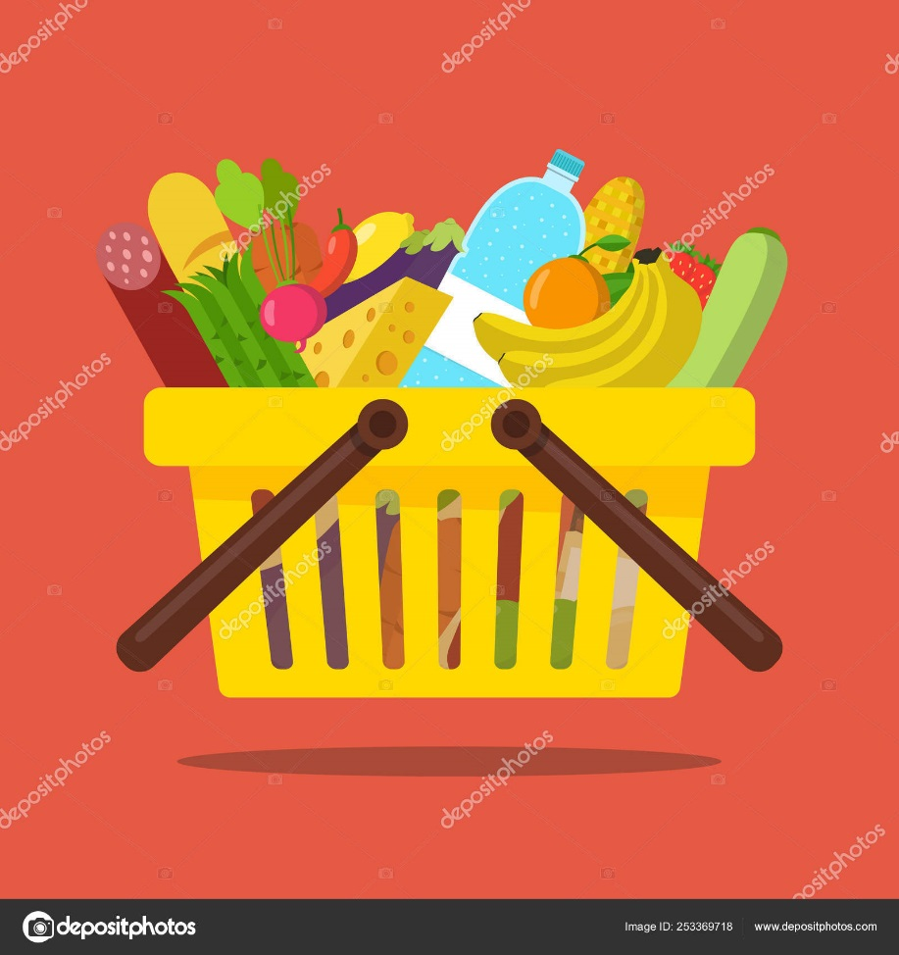
Products
Category | Monthly consumption (kg)
Dairy products | 4
Meat and Fish | 16
Vegetables and Fruits | 17
Bakery products | 9
Sweets | 1
Other (spices, sugar, tea, salt) | 0,4

Slide 4

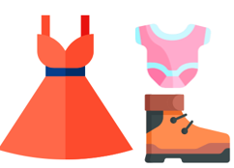
Non-food Products
Category | Monthly consumption (rubles)
Transport | 10000
Clothes | 10000
Household Goods | 4000
Essential, Medicines | 4500
Necessary Payment | 15000

Slide 5

In total
We spend 95000 rubles per month.
On average per person 31500 rubles.
Government considers, that Consumer basket costs about
10,000 rubles!

