Slide 1
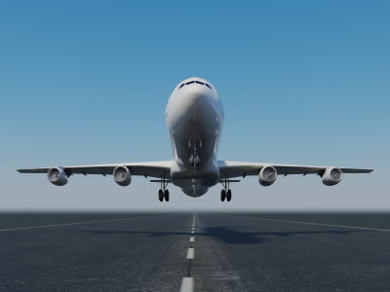
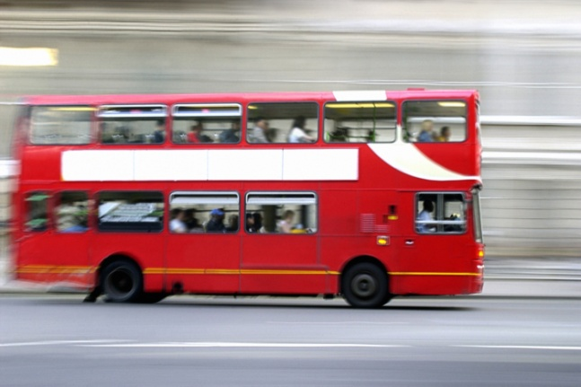
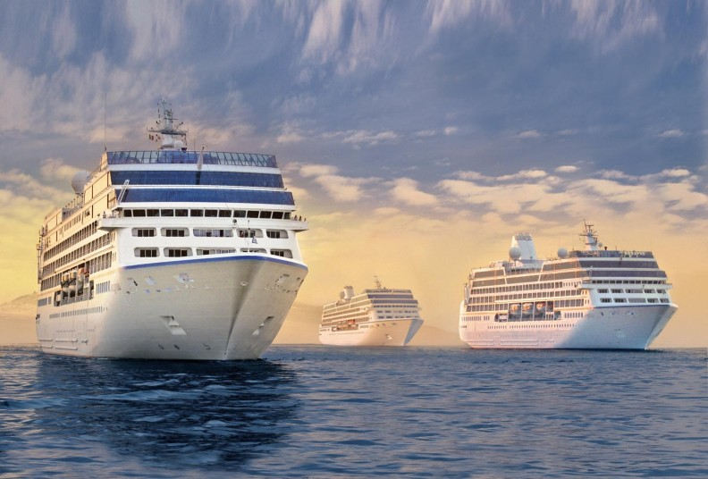
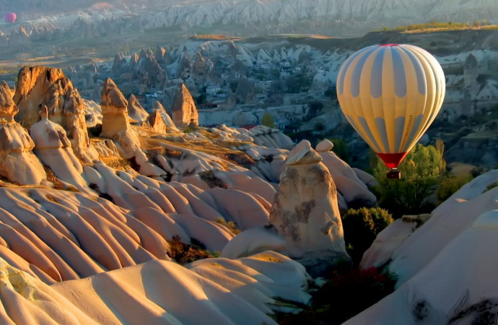
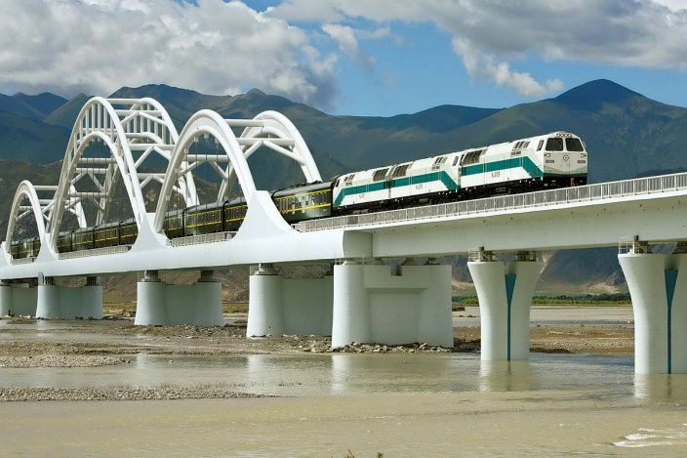
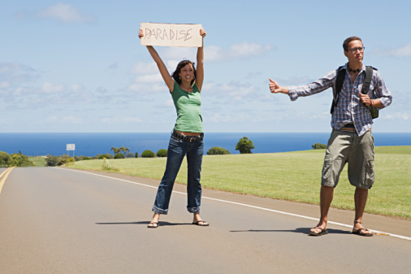
The World of Travelling
Hitchhiking

Slide 2
Travel quotes
The World is a book, and those who do not travel read only a page. ~ St. Augustine
Those who know nothing of foreign languages know nothing of their own. ~ Goethe
A man travels the world in search of what he needs and returns home to find it. ~ George Moore
The whole object of travel is not to set foot on foreign land; it is at last to set foot on one's own country as a foreign land. ~ G.K. Chesterton
To travel is to discover that everyone is wrong about other countries.
~ Aldous Huxley
The traveller sees what he sees. The tourist sees what he has come to see. ~ G.K. Chesterton

Slide 3
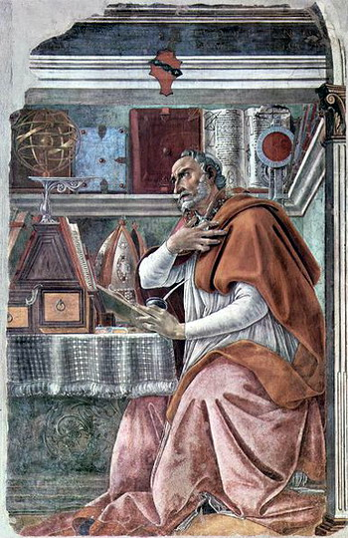
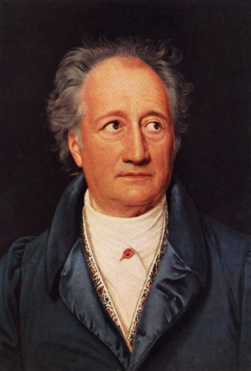
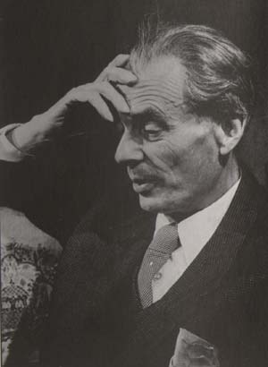
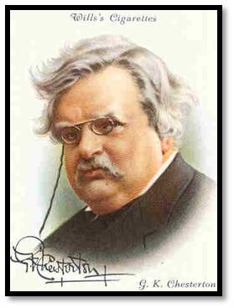
Travel quotes
He who would travel happily must travel light. ~ Antoine de Saint-Exupery
When you travel, remember that a foreign country is not designed to make you comfortable. It is designed to make its own people comfortable. ~ Clifton Fadiman
Certainly, travel is more than the seeing of sights; it is a change that goes on in the ideas of living. ~ Miriam Beard
When preparing to travel, lay out all your clothes and all your money. Then take half the clothes and twice the money. ~ Susan Heller

Slide 4
Why travel abroad?
to discover new places
to see the sights
to meet new people
to take part in exchange programs
to practise languages
for the sake of travelling
to relax
to participate in sports competitions
to do business
to do the shopping

Slide 5

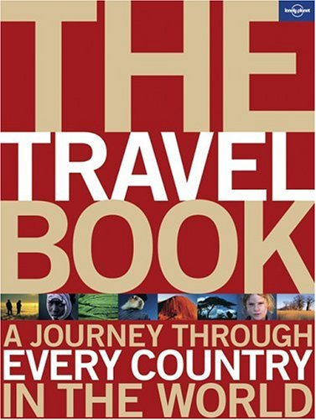
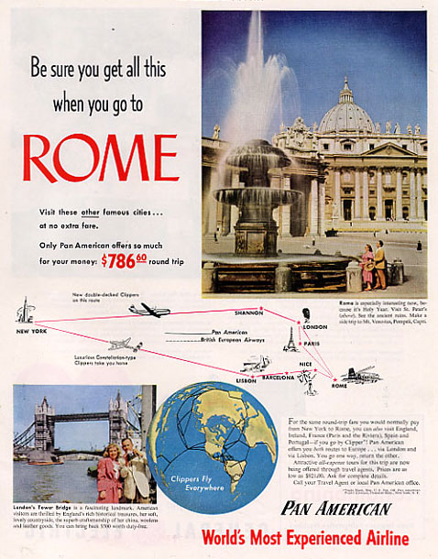

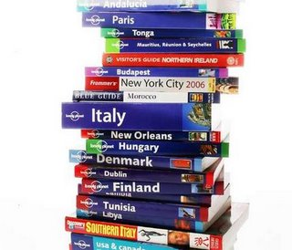
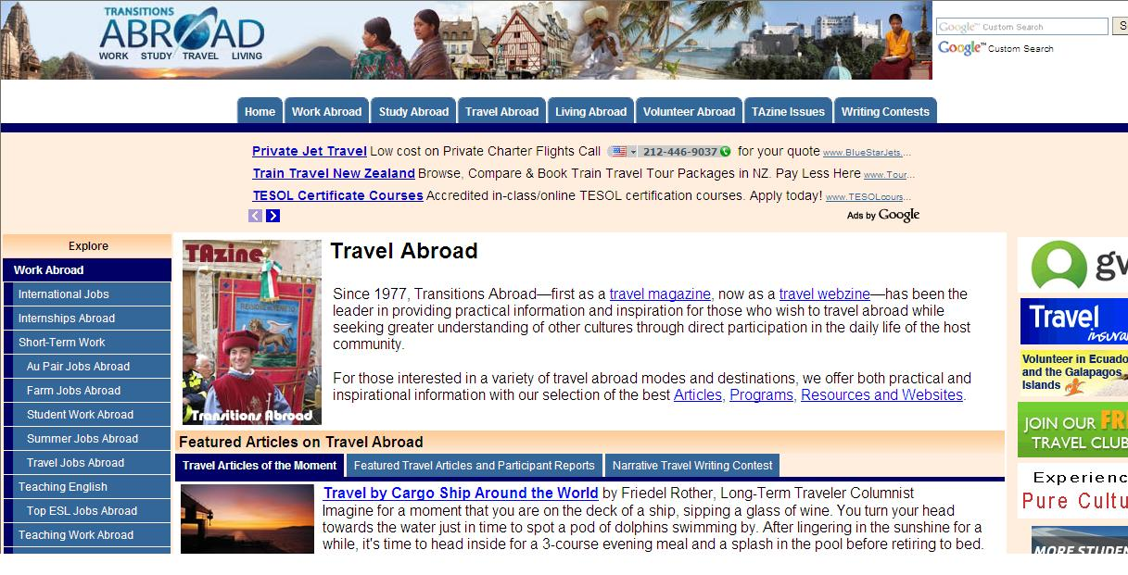
Where to Get Information?

Slide 6

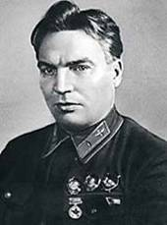

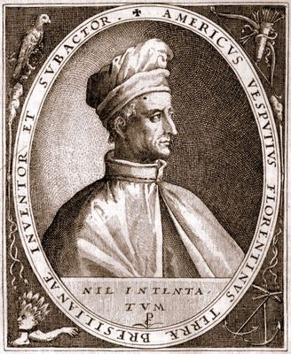


Famous Travellers
Vladimir Lysenko
Valeri Chkalov
Captain Cook
Yuri Senkevich
Amerigo Vespucci

Slide 7
Valeri Chkalov flew over the North Pole to America in 1937.
Christopher Columbus discovered America in 1492.
Vladimir Lysenko travelled round the world
Captain Cook made a sea trip round the world twice in 1771, 1774.
Nikolai Przhevalski walked 35000 km across Central Asia between 1870 and 1873.
Yuri Senkevich visited over a hundred countries.
Amerigo Vespucci (March 9, 1454 – February 22, 1512) was an Italian explorer, navigator and cartographer.

